Slide 1
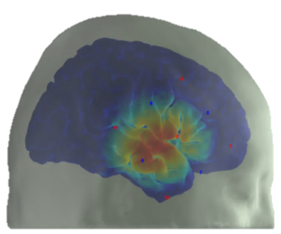
Parent Information Sheet: Pilot Normally-Hearing: Questionnaire Only - Version1.0 – 01/06/20 (IRAS ID 257177)
Towards the development of an objective measure of executive function in children with a cochlear implant using functional near infrared spectroscopy (fNIRS)
We invite your child to take part in our research
Before you decide if you want your child to take part, it is important for you to understand why the research is being done and what it will involve.
Please read this information carefully. Discuss it with friends and relatives if you wish.
You are free to decide whether or not your child takes part in this study.
Please ask us if the information is not clear or if you want more information.
Contents
Why are we doing this research?
Why is my child being asked to take part?
Does my child have to take part?
What will my child need to do if they take part?
When will the research appointment take place?
What are the possible benefits of taking part?
What are the possible risks of taking part?
Will my child’s results be confidential?
What will happen to the results?
Use of your child’s personal data
Who is organising and funding the study?
Who has reviewed the study?
What if there is a problem?
How does my child take part?
Where is the research team based?
Important things that you need to know
We are looking for children aged 4-6 years old without any hearing problems or concerns.
Cochlear implants can provide a sensation of hearing to someone who has a severe-to-profound hearing loss. Most children who receive cochlear implants learn to successfully use language and understand speech, however outcomes vary between individuals.
We want to understand why some children can understand speech and language well with cochlear implants and some children cannot.
We want to know whether a child’s behavior is related to their understanding of speech and learning of words.
This research study originally used functional near-infrared spectroscopy (fNIRS), a technique for measuring brain activity. However, due to the coronavirus (COVID-19) pandemic, we are not performing face-to-face research sessions until it is safe to do so. Therefore, at present we can no longer carry out this fNIRS brain imaging, which we were using to measure how active a particular part of a child’s brain is while they perform certain behavioural tasks.
Instead we now only ask you, as a parent/guardian, to complete 2 questionnaires, one of which is related to your child’s behaviour and the other to their communication and language skills.
It is also very important to know how behaviour relates to speech and language in children with normal hearing, hence why we invite your child to take part in our study.
Your child will receive a £10 voucher for taking part in the study.
Your child can stop taking part in the study at any time and without having to give a reason.
How to contact us
If you have any questions about this study, please contact Dr Rachael Lawrence:
Email: msxrl15@nottingham.ac.uk
Or call: 0115 823 2612
Page 1 of 4

Slide 2
1 Why are we doing this research?
3 Does my child have to take part?
Cochlear implants partially restore hearing to children with a severe-to-profound hearing loss and most children who receive cochlear implants learn to successfully understand speech and use language.
However, speech and language abilities in children with cochlear implants vary widely and we still don’t fully understand why.
All children, like adults, have different patterns of behaviour.
We want to know whether certain aspects of a child’s behavior is related to their understanding of speech and learning of words and language.
One questionnaire that we ask you to complete enquires about elements of your child’s behaviour such as memory and inhibition, the other about language and communication skills.
We hope that in the future our findings will be of benefit to patients with and without cochlear implants. If we can identify a predictive pattern between behaviour and speech and language skills, we may be able to offer any required rehabilitation at any earlier stage through the recognition of particular behaviours.
It is also important to know how behaviour relates to language in children with normal hearing so that we can compare results from studies that we are conducting for children with cochlear implants.
No. It is up to you to decide whether or not your child takes part. If you decide to let your child take part you will have the chance to ask questions about anything on this information sheet and the study itself. You will then be asked to sign a consent form to confirm that you understand what is involved.
If your child decides to take part they are free to leave the study at any time without giving a reason.
If your child withdraws from the study, you will be able to decide whether or not any personal or research data acquired from your child during the study can still be used in our results analysis at the end of the study. If you consent for this data still to be used, you can change your mind about this at anytime. If you don’t want your child’s data to be used in the final analysis, we will ensure all your child’s data is destroyed.
4 What will my child need to do
if they take part?
If your child is eligible to take part in the study you as a parent/guardian will be invited to complete two questionnaires. You can complete both of these from your home. No visits to our research department are required.
We will then ask you to:
sign a consent form telling us that you understand the information and that you are happy for you and your child to take part in the study. We will return a copy of the signed consent form for you to keep.
In terms of the two questionnaires:
The first will ask questions about your child’s behaviour and will take between 10-15 minutes to complete.
The second will ask questions about your child’s communication and speech and language skills and will take also take about 10-15 minutes to complete.
The consent form and questionnaires can be sent to you (and returned to the research team) via post or electronically, whatever your preference. We will pay for all postage costs. In terms of the questionnaires, there is also the option of completing these via a telephone conversation or an online interaction with a researcher (Dr Rachael Lawrence) via a platform such as Skype or Zoom etc.
2 Why is my child being asked to take part?
Your child is eligible to take part if they:
are between 4 and 6 years old
have no known problems with their hearing
are a native English speaker
have normal or corrected-to-normal vision
do not have a motor impairment (for example, Cerebral Palsy)
do not have a language impairment like Dyslexia or Specific Language Impairment
do not have a cognitive impairment (for example, due to a brain injury)
are able and willing to take part in all study assessments
If you are not sure if your child is eligible please contact us and we can discuss this with you.
IRAS ID 257177
Version 1.0 – 0106/2020
Page 2 of 4

Slide 3
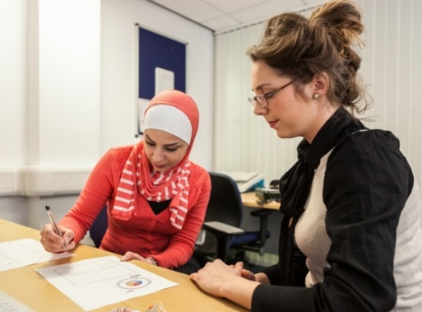
5 When will the research take place?
10 Use of your child’s personal data
We can post/email the questionnaires and consent form (and they can be returned to us) at your convenience. If you would prefer to have a telephone or online interaction to complete the questionnaires, these can take place Monday to Friday during normal working hours.
The NIHR Nottingham Hearing Biomedical Research Centre will use your name and contact details to contact you about the research study, and make sure that relevant information about the study is recorded for your care, and to oversee the quality of the study. Individuals from Nottingham University Hospitals NHS Trust and regulatory organisations may look at your child’s research records to check the accuracy of the research study. The NIHR Nottingham Hearing Biomedical Research Centre will pass these details to Nottingham University Hospitals NHS Trust along with the information collected from your child.
The only people in Nottingham University Hospitals NHS Trust who will have access to information that identifies your child will be people who need to contact you for reasons related to the study or audit the data collection process. The people who analyse the information will not be able to identify your child and will not be able to find out you or your child’s name or contact details.
The NIHR Nottingham Hearing Biomedical Research Centre will keep identifiable information about your child from this study for at least 5 years after the study has finished. This will include photographs and videos taken during the study.
The research team at NIHR Nottingham Hearing Biomedical Research Centre will not require access to your child’s medical records at Nottingham University Hospitals NHS Trust during the research study.
6 What are the possible benefits of taking part?
There are no direct benefits to your child for taking part. However, the results will inform future research aiming to develop a tool which can detect children who are not hearing well with their cochlear implants.
7 What are the possible risks of taking part?
There are no risks associated with this study.
8 Will the results be kept confidential?
Yes. All information that we collect including any photographs and video recordings will be kept strictly confidential and will be stored at the Nottingham Biomedical Research Centre.
Results will not include your child’s name or where you live. Results saved on a computer will be protected with a password so that only the research team and appropriate regulatory authorities have access.
9 What will happen to the results?
We cannot provide you and your child with individual results. We can provide a report of the group results and our findings once the study has finished.
The overall results of the study will be presented at national and international conferences. We will also publish the results in scientific journals. We will not use your child’s name in any publications.
Version 1.0 – 01/06/2020
IRAS ID 257177
Page 3 of 4

Slide 4
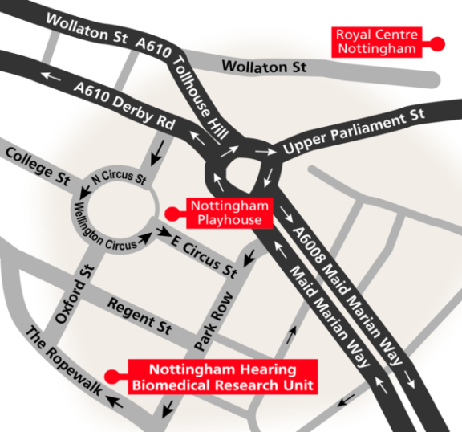
11 Who is organising and funding the research?
15 Where is the research team based?
The research is organised by the Nottingham Hearing Biomedical Research Unit and Nottingham Hospitals NHS Trust.
The research is funded by The Medical Research Council.
The research is sponsored by Nottingham University Hospitals NHS Trust .
During the COVID-19 pandemic, all the research team are currently working from home until it is safe to return to work.
However, we are normally based at:
Nottingham Biomedical Research Centre, Ropewalk House, 113 The Ropewalk, Nottingham,
NG1 5DU.
12 Who has reviewed the research?
This study has been approved by:
The Research Ethics Committee (ref no: 257177).
13 What if there is a problem?
Our staff always aim to conduct research in a caring and respectful way.
If you do have a complaint about the way you have been treated during the research we would be happy to help. Please contact the Chief Investigator:
Dr Douglas Hartley, on 0115 823 2600 or email douglas.hartley@nottingham.ac.uk
If we cannot fix your problem, or you wish to talk to someone who is independent from the Nottingham Biomedical Research Centre, then please contact the Research Sponsor:
Nottingham University Hospitals NHS Trust Patient Advice and Liaison Service (PALS), on 0800 183 0204 or email PALS@nuh.nhs.uk
14 How does my child take part?
If you are interested in your child taking part in the study please contact:
Dr Rachael Lawrence:
Email: msxrl15@nottingham.ac.uk
Or call: 0115 823 2612
Version 1.0 – 01/06/2020
IRAS ID 257177
Page 4 of 4

