Slide 1
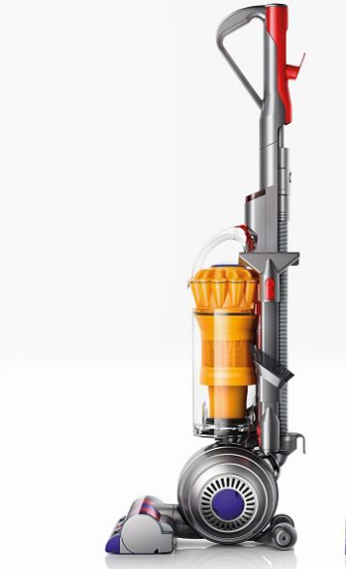
Please look after your Cochlear Implant Equipment!
Help us to help the NHS
A sound processor costs as much as a holiday to Disneyland
A rechargeable battery pack costs as much as a new Ipad
Each repair costs as much as good vacuum cleaner

